Slide 1
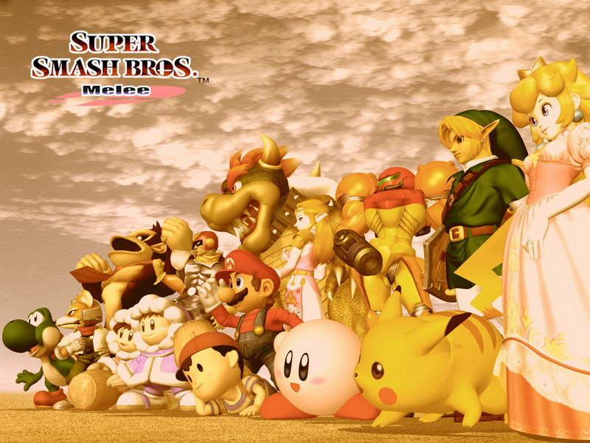
AI beats professional players at Super Smash Bros. video game
Jason Less
Lab 4, Assignment 10

Slide 2
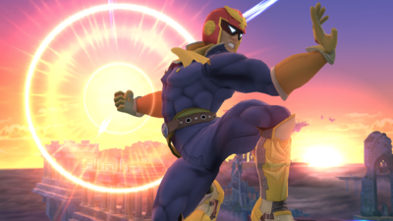
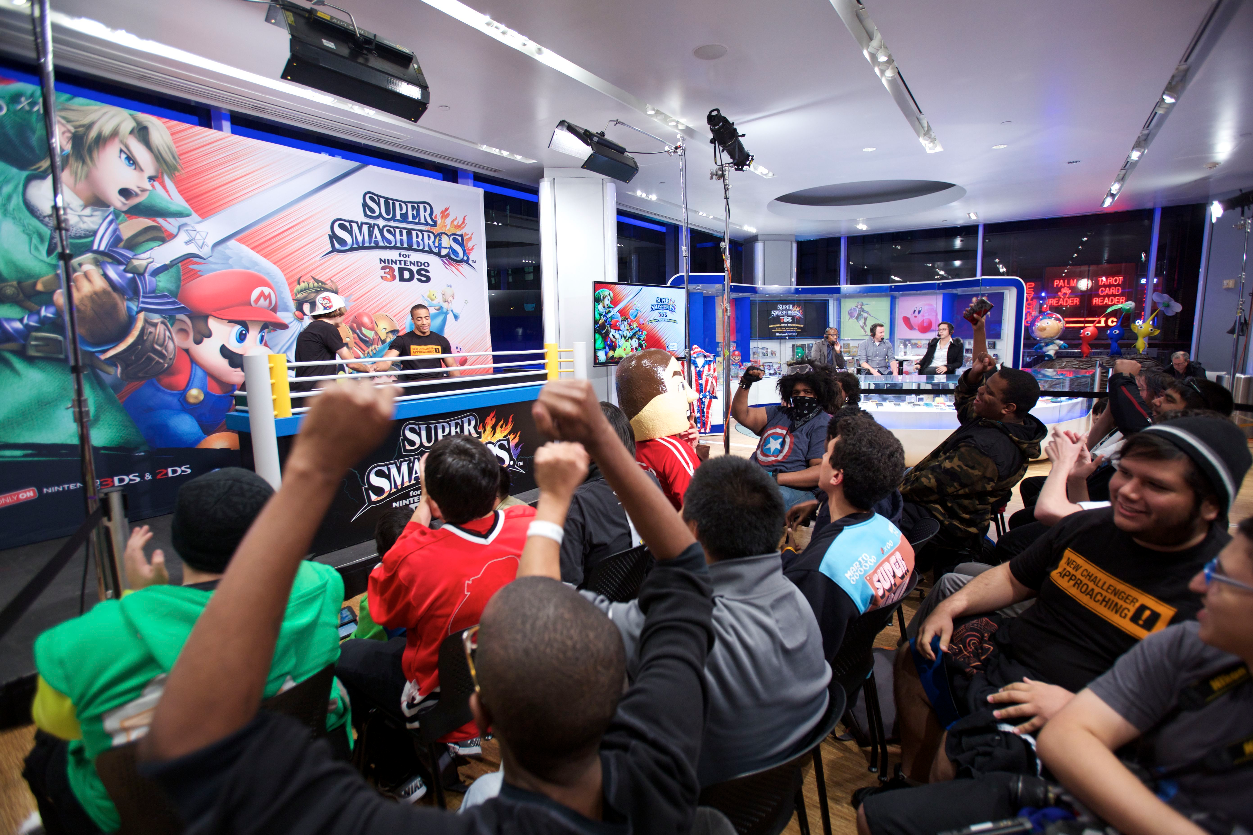
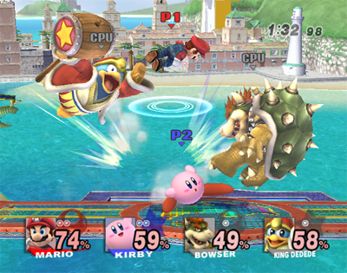
Introduction
Application of artificial intelligence to multiplayer video games
Team from MIT created an AI to play Super Smash Bros. as Captain Falcon
Within two weeks of practice the AI beat 10 top 100 human players in the world
Programmed a branch of machine learning, called “reinforcement learning”

Slide 3
New Challenges
Traditional use of AI in games involves strategy games (i.e. Chess and Go)
Able to plan many moves ahead
Analyze a large data set of permutations to apply strategy
Multiplayer video games are more dynamic
Real-time game against one or many opponents
Less strategy, more dependent on reaction time
Moves can have negative effects (i.e. reload time)

Slide 4
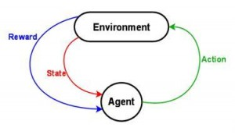
Method of Learning
Deep and Reinforcement Learning
Goal: Perform an action on the environment with the goal of getting the reward (defeat opponent)
Exposed to large amounts of data via coordinates of in-game items, map elements
AI performs an action on its opponent (input)
Learns from previous actions if successful or not (output)
Adapts to develop best fighting strategy

Slide 5
Elements of Success
Reaction time
Computers excel at fast reaction times
Computer: ~33ms, Human: +200ms
Developed strong fight strategies and techniques
From repetition and trial-and-error (of reinforcement learning)
Precise movements, reduced button errors

Slide 6
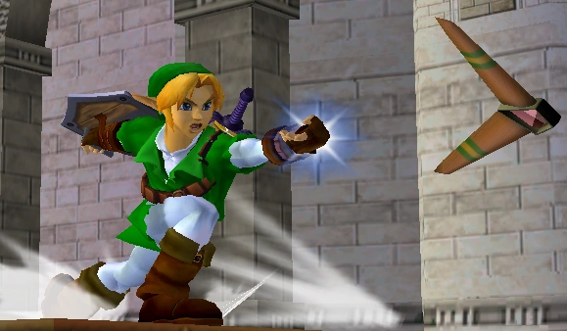
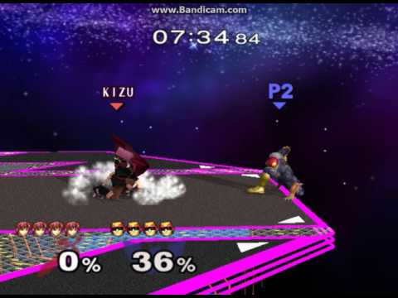
Flaws
Not programmed to deal with projectiles
Can only play as Captain Falcon (as he doesn’t use projectiles)
Fatal crouching error
If opponent crouches in corner, AI panics, and kills itself

Slide 7
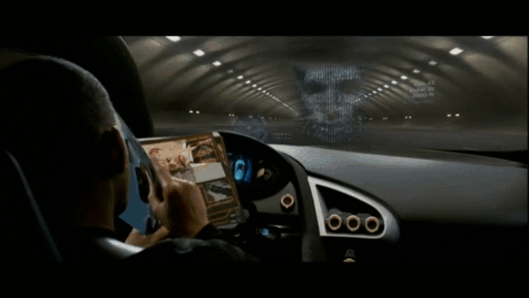
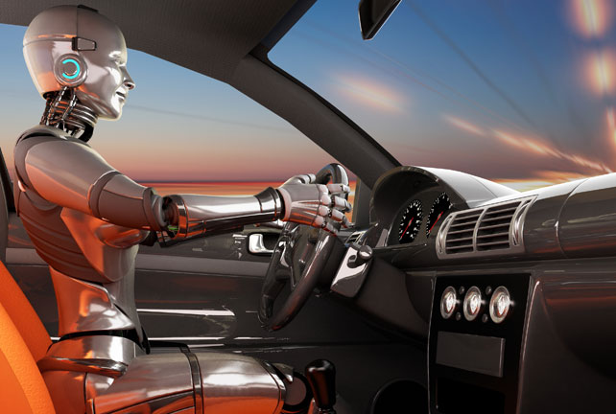
Applications
Unreal speed to learn and adapt
Able to master a game in 2 weeks, which took the top players years to hone their skills
Implementing the deep machine and reinforcement learning for the AI capable of a wide variety of applications:
Autonomous cars
Robots in the work force (e.g. truck drivers) etc.

